Slide 1
Capital Allocation

Slide 2
Risk Aversion
As shown in the last lecture (“play it safe” or “toss a coin” example), most investors are risk averse:
  Given the same return and different risk alternatives, we will seek the asset offering the least risk.
  Or, the higher the degree of risk, the greater the return that we will demand.

Slide 3
Risk Aversion and Utility Functions
Types of investors based on risk preferences:
  Risk averse (Prefer to “Play it safe”)
  Risk neutral (Indifferent)
  Risk seeking (Prefer to “Toss a coin”)
A utility function describes how good or attractive an investment is to a person taking into account expected return and risk.
  A common specification of utility function:
  U = E(r) – 0.5 A σ ²
    A measures the degree of risk aversion.

Slide 4
Risk Aversion and Utility Functions
A is the coefficient of risk aversion (how much you dislike risk).
  If A > 0 you are risk averse. The bigger A is, the more risk averse you are.
  If A = 0 you are risk neutral; you only care about expected return.
  If A < 0 you actually like risk.
In modern portfolio theory, investors are assumed to be risk averse.

Slide 5
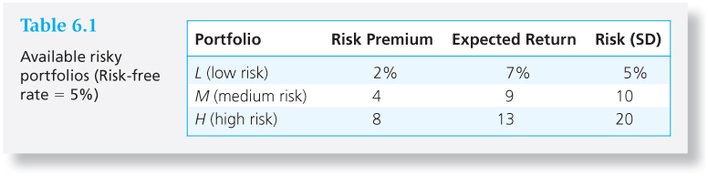
An Example
You are going to invest $100,000 for one year. You check with your broker and find that you can buy T-bills with a face value $100 for $95.2.
T-Bill: r = 100/95.2 – 1 ≈ 5%
Your broker says you can also invest in any of the following risky assets:

Slide 6
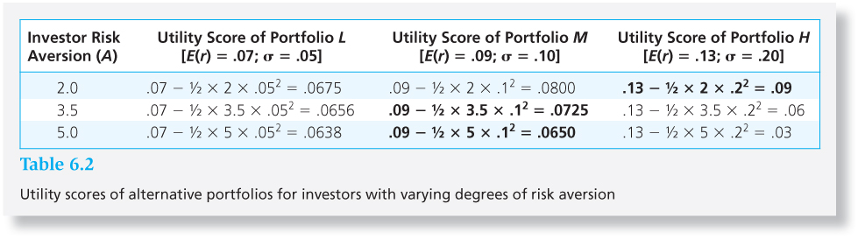
Utility scores of alternate assets for investors with varying risk aversion
What’s the utility score of the risk-free asset?

Slide 7
Dominance Principle
Expected Return
4
2
3
1
Variance or Standard Deviation
• 2 dominates 1; has a higher return for same risk
• 2 dominates 3; has a lower risk for same return
• 4 dominates 3; has a higher return for same risk

Slide 8
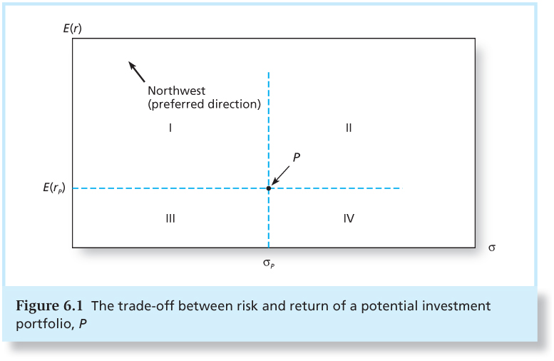
Trade-off Between Risk and Returns

Slide 9
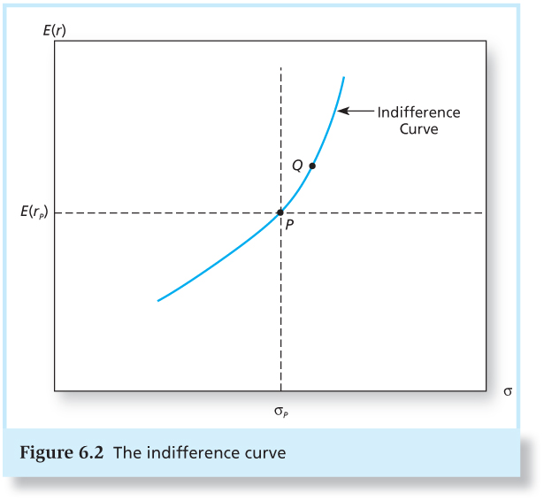
The Indifference Curve
Assume your risk aversion is 5 in the last example, what would other options have to look like to make you equally happy as portfolio M?
    E(r) – 0.5 A σ² = 0.065 → E(r) = 0.065 + 2.5 σ²
More risk-averse => more upward-sloping

Slide 10
A Set of Indifference Curves
Expected Return
Increasing utility to northwest
Standard Deviation

Slide 11
You Can Split - Asset Allocation
You do not have to put the whole money in one asset. You could put some money into risky-free assets and some into risky assets.
A portfolio is a collection of assets.
  The weights fundamentally define a portfolio.
  If you own only one asset, you still have a portfolio, a pretty simple one.
The most basic asset allocation exercise concerns dividing investment between a risky asset and a risk-free asset – a complete portfolio.

Slide 12
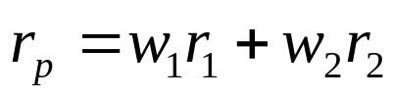

Rules of Portfolio Mathematics - Return on a Portfolio
The return on a portfolio is a weighted average of the returns of each asset comprising the portfolio, with the portfolio proportions as weights.
w₁ = Proportion of funds in security 1
w₂ = Proportion of funds in security 2
r₁ = Return on security 1
r₂ = Return on security 2
It follows that expected returns have the same relation:

Slide 13
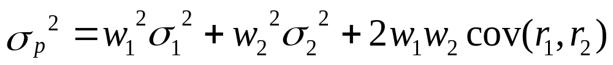
Rules of Portfolio Mathematics - Portfolio Risk
When two assets with variances σ₁² and σ₂², respectively, are combined into a portfolio with portfolio weights w₁ and w₂, respectively, the portfolio variance is given by:
  Cov(r₁,r₂) = Covariance of returns for security 1 and security 2

Slide 14
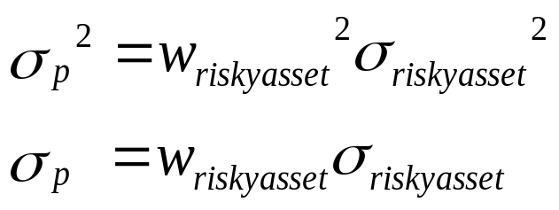
Rules of Portfolio Mathematics - Portfolio Risk
When a risky asset is combined with a risk-free asset, the portfolio variance equals the risky asset’s variance multiplied by the squared portfolio proportion invested in the risky asset.

Slide 15
Asset Allocation Example
Suppose you put 30% of your money in T-bills and 70% in a risky portfolio P (i.e. index fund). What’s the utility associated with this new portfolio (the complete portfolio C)?
Assume expected return and standard deviation of the risky portfolio P equal 15% and 22%. In notation, E(r_{P}) = 0.15 and σ_{P} = 0.22. Also assume that the risk-free return r_{f} = 0.07.
What’s the expected return and standard deviation of this complete portfolio C?

Slide 16
Asset Allocation Example - contd
Let y = proportion of portfolio in risky asset. For the complete portfolio C,
E(r_{C})
=
σ_{C}
=
Given the utility function and the coefficient of risk aversion (A = 5), is portfolio C preferred over putting all your money into one asset? What if A = 4?

Slide 17
Asset Allocation Example - contd
Actually we should find the portfolio with the highest utility. What’s the range of risk-return combinations for possible portfolios C?
From last slide, these combinations satisfy the following:
E(r_{C}) = y × E(r_{P}) + (1 − y) × r_{f}
= 0.15 y + 0.07 (1 − y) = 0.07 + 0.08 y
σ_{C} = y × σ_{P} = 0.22 y
It follows that E(r_{C}) = 0.07 + (8/22) σ_{C}.
  This is the equation of a straight line, known as CAL (Capital Allocation Line).

Slide 18
Capital Allocation Line
All possible risk-return combinations should be on this line.
y | E(r_{C}) = 0.15y+0.07(1-y) | σ_{C} = 0.22y
0.00 | 7.00% | 0.00%
0.10 | 7.80% | 2.20%
0.20 | 8.60% | 4.40%
0.30 | 9.40% | 6.60%
0.40 | 10.20% | 8.80%
0.50 | 11.00% | 11.00%
0.60 | 11.80% | 13.20%
0.70 | 12.60% | 15.40%
0.80 | 13.40% | 17.60%
0.90 | 14.20% | 19.80%
1.00 | 15.00% | 22.00%

Slide 19
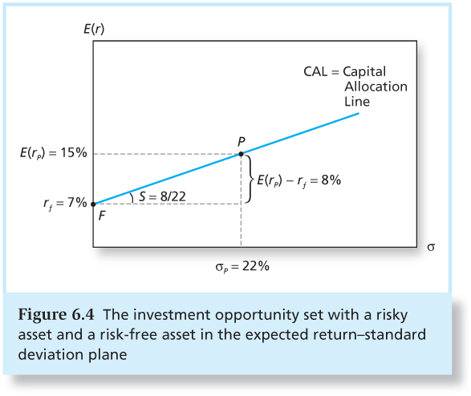
Capital Allocation Line - contd
What does the slope mean?
Risk premium per unit of standard deviation

Slide 20

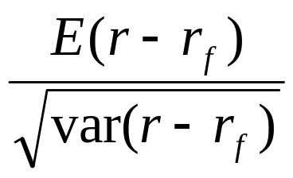
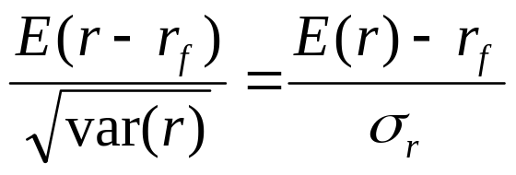
Sharpe Ratio
Proposed by William Sharpe (Nobel winner 1990)
Sharpe ratio = Risk premium/SD of excess return
=
If r_{f} is a constant risk-free return throughout the period, then Sharpe ratio =
It is also called the reward-to-volatility ratio, and is a basic measure of portfolio performance.

Slide 21
Capital Allocation Line - contd
When you invest all in risk-free security, y = 0.00. When you invest all in risky securities, y = 1.00. We also considered a case of y = 0.70.
What weights are possible?
  y can be any percentage between 0 and 1.
  y > 1: borrowing
  y < 0 : short the risky assets
  (If y<0, we need to use the absolute value |y| to calculate the portfolio σ)

Slide 22
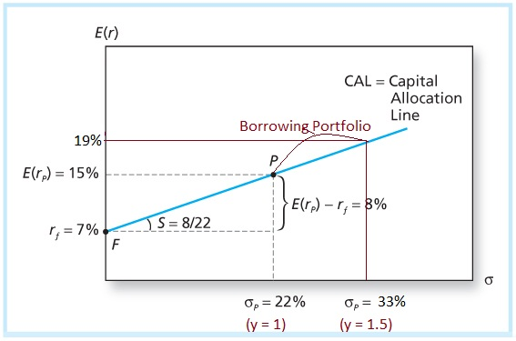
CAL with Borrowing
The investor would be holding a negative or a short position in risk-free asset.

Slide 23
Pick the Best Portfolio
We have examined all the feasible combinations. Now just need to pick the portfolio that gives you the highest utility.
We need to solve the following problem to choose an optimal value of y (denoted by y*):
  Substitute E(r_{C}) and σ_{C} to make it just a function of y
Max U = E(r_{C}) – 0.5 A σ_{C}²
= r_{f} + y ( E(r_{P}) – r_{f} ) – 0.5 A y² σ_{P}²
The answer is given by:
y* = ( E(r_{P}) – r_{f} ) / (A σ_{P}² )
= 1.653 / A
for E(r_{P}) = 0.15, r_{f} = 0.07, and σ_{P} = 0.22

Slide 24
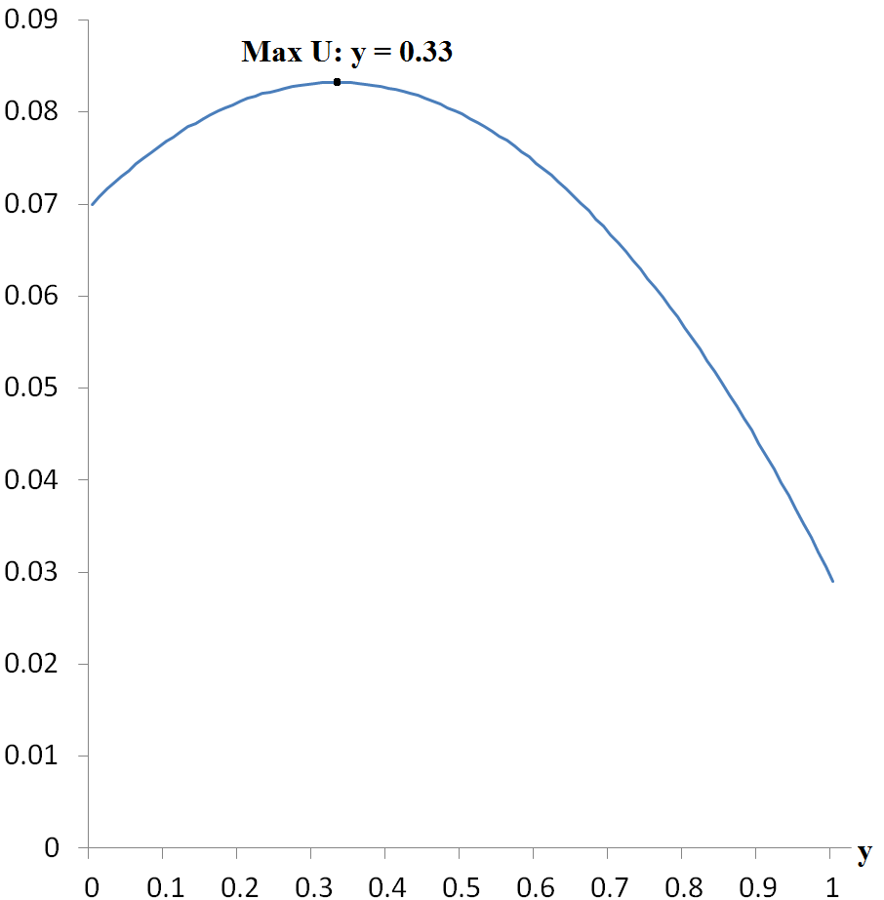
Utility when A = 5

Slide 25
Optimal Asset Allocation - Finally
Notice the following solutions for the given risk aversions:
But no matter how high the risk aversion A, the investor will hold at least some risky assets.
A | y*
1 | 1.65
2 | 0.83
3 | 0.55
4 | 0.41
5 | 0.33

Slide 26
Optimal Asset Allocation
E(r_{c})
U(r) with A=4
U(r) with A=5
CAL
E(r_{p}) = 15%
P
E(r_{c}) = 13.64%
E(r_{c}) = 9.64%
r_{f} = 7%
0
σ_{c}
σ_{c}= 7.26%
(y = 0.33)
σ_{c} = 18.26%
(y = 0.41)
σ_{p} = 22%
(y=1)

Slide 27
Optimal Asset Allocation
E(r_{c})
U(r) with A=4
U(r) with A=5
CAL
E(r_{p}) = 15%
P
E(r_{c}) = 13.64%
E(r_{c}) = 9.64%
r_{f} = 7%
0
σ_{c}
σ_{c}= 7.26%
(y = 0.33)
σ_{c} = 18.26%
(y = 0.41)
σ_{p} = 22%
(y=1)

Slide 28
Optimal Asset Allocation
Greater levels of risk aversion lead to larger proportions of the risk free rate
Lower levels of risk aversion lead to larger proportions of the portfolio of risky assets
Willingness to accept high levels of risk for high levels of returns would result in leveraged combinations

Slide 29
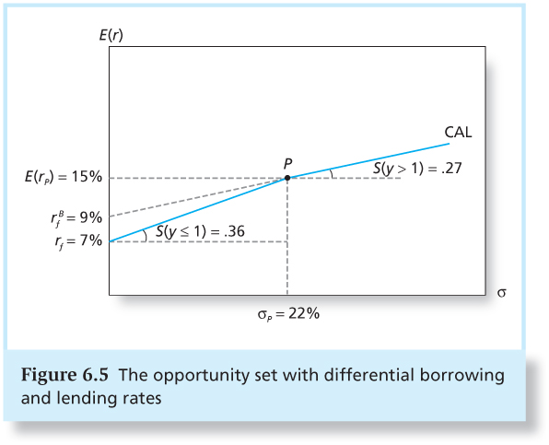
What If Lending and Borrowing Rates are Different?
Suppose the borrowing rate is 9% :

Slide 30
Exercise
Suppose an investor has an A = 1.1, will he/she be affected by the borrowing rate?

Slide 31
Challenging Concepts
A broad category of risky assets accounted for appx 74% of the total wealth in the U.S. economy. So what is the average risk aversion of a “representative investor”?
  y* = ( E(r_{P}) – r_{f} ) / (A σ_{P}² )
  or, 0.74 = 0.082/(A×0.208²)
  or, A = 2.6
Alternately, if you invest > 74% of your wealth in risky assets, you are more aggressive than the representative (i.e., average) investor. Vice versa for < 74%.
Risky assets does not just mean stocks. It includes real estate, private businesses, commodities, etc.

Slide 32

Words of wisdom from an industry icon
John Bogle of Vanguard funds:
The most fundamental decision of investing is the allocation of your assets: How much should you own in stocks? How much should you own in bonds? How much should you own in cash reserves? … That decision has been shown to account for an astonishing 94% of the difference in total returns achieved by institutionally managed pension funds… There is no reason to believe that the same relationship does not hold true for individual investors.

